Slide 1

Optimization Approach for Managing Integrated Petrochemical Business Planning
Suryo Widyanto, Wisni R Handayani, Supriyanto Suparno
PT. Chandra Asri Petrochemical (CAP)
Indonesia
Arturo Cervantes and Bhieng Tjoa
Optience
USA

Slide 2
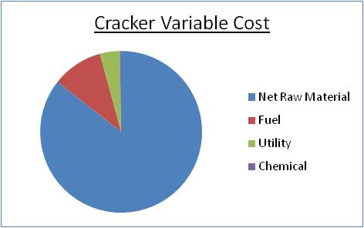
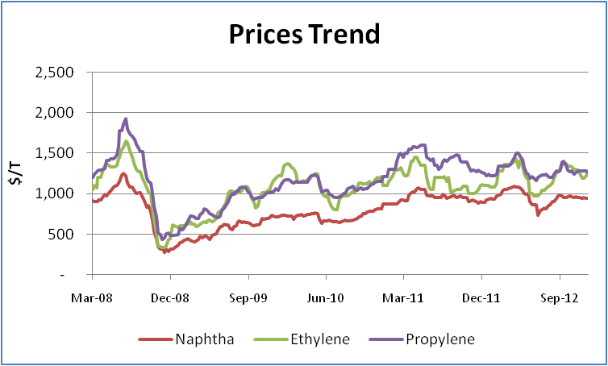
Background:
Cost Structure
80 ~ 90%
Prices are very volatile
Major Challenges:
Optimum Feedstock selection / blending = Optimum Product Yield
s.t. Plant & Business Constraints
➔ Maximum Profit & Increase Business Competitiveness
Notes:
Ethylene plant who run the business by using naphtha as feedstock knows that feedstock took the largest part of cracker VC. It is about 80-90%.
Looking and the trend, feedstock and product price are very volatile.
It makes at different market condition, different product blend can give a max profit.
Because of that we need to find the opt feedstock selection/blending to get opt product yield, in order to get max profit and increase company competitiveness.

Slide 3

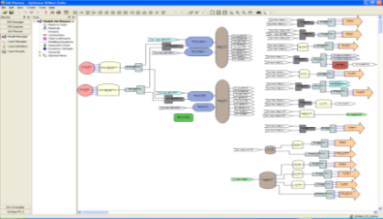
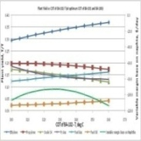
Olefins Business Planning
Feedstock Info
Ethylene Plant
Inventories
Business Policy:
Yield
Light
$
ETY
Demands
ADVANCED /
SIMULTANEOUS
OPTIMIZATION
PPY
$
Heavy
ETA
NAP Cost
BBP
GSL
ETY & PPY Demands
Optimal NAP ratio (L/H)?
$
Complex decision for business planning :
Feedstock selection (Naphtha, LPG)
Feedstock blending and allocation
Plant Condition (COT, Furnaces, Capacity, Constraint, by-product, recycle, Fuel balance, etc.)
Downstream plants allocation
Product portfolio, demands, allocation
Inventories, delivery
Cost and Market pricing
Multi period planning
OPTIMUM ???
SOLUTION
Large number of possible decisions
Thousands of degree of freedom
Notes:
*In making a business planning we should face a complex decision such as feedstock selection, blending & allocation, plant condition, downstream allocation until the period of planning.
To make it optimum, we should face a large number of possible decision and thousands combination degree of freedom.
By looking at those backgrounds, we think that we need an advance optimization as the solution.

Slide 4

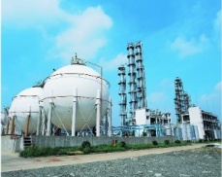

CAP Business Planning
Historical Perspective – Optimization Approach
COMPANY
COMPETITIVENESS
Linear Programming -Variable Margin Optimization – For Mass Balance, Planning & Analysis
Y12 - Current
Spreadsheet Optimization – For Mass Balance & Planning
Advanced Optimization
For Mass and Energy Balances, Production Planning, Scheduling, and Strategic Planning
Y08-Y12
BeforeY08
Downstream & Tank yard are not included, utilities is calculated separately & need some assumptions
Narrow coverage, less species and manual usage
- MINLP and NLP models
- Integrate the olefin demand with the downstream processes
Notes:
CAP business planning has a continuous opt.
We started it from before 2008 by spreadsheet opt, but its only for narrow usage.
Continue to 2008 to 2012, we used Linear Programming – VM optimization. It help us a lot, but still remain some flaws such as downstream and tank yard are not included and utilities is calculated separately.
And to face more dynamic condition like nowadays, we need a wider coverage optimization. And from 2012 we used an advanced optimization to achieve our target as a competitive company.

Slide 5
CAP Business Planning
Advanced Optimization
Current Optimization Tool – SCMart Suite
Advanced Optimization with
Single Modeling Platform
One system for:
- Strategic Planning
- Production Planning
- Production Scheduling
- Performance Analysis
Support multi-layer modeling aggregation (from high level to more detail models)
Multilayers Coverage
Strategic Planning
Information Detail
Production Planning
Benefit Opportunities
Production Scheduling
Business Performance Analysis Tool
Notes:
This is our current opt tool. We call it simultaneous opt.
This is one system with multi layer coverage. It covers strategic planning, production planning and scheduling also performance analysis.
It support from high level to more detail models.

Slide 6
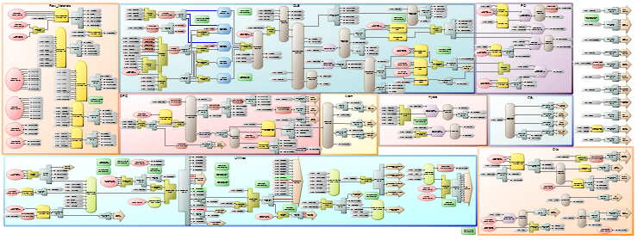
Advanced Optimization
Modeling Approach
Represent in ‘block wise’ modeling approach
1
2
3
10
4
5
6
7
9
8
Block Wise modeling approach is used to make grouping easier
The model is divided into 10 blocks, cover from upstream to downstream
Each block represent the key constraint in the plant, it’s connected each other and solved in a closed loop
Notes:
If we go to detail program scheme, as we can see that the program represent our plant into block wise modeling approach.
It is used to make grouping easier.
The model itself is divided into 10 blocks, cover from upstream to the downstream.
Each block represent the key constraint in the plant, its connected each others and solved in a closed loop.

Slide 7
Advanced Optimization
Application Performance
The model has been tested/validated with the actual condition, and we can get the similar result.
Comparison with previous program
Notes:
Since the previous tool support us well, we set the expectation high for our new opt.
The model has been tested/validated with the actual condition, and we can get the similar result.
Compare to the previous model, current tool has more advantages that cannot be achieved in the previous tool such as naphtha evaluation, sensitivity case, period of evaluation, downstream processes, inventory balance, utility, optimization base and utilization.
Next I’ll show you the examples.

Slide 8
Advanced Optimization
Example: Planning Case – Feedstock Selection
Feedstock Selection/Valuation
All feedstock available can be evaluated at the same time
Feedstock value/rank is shown by each shadow price
The naphtha is selected by considering its price, quality, availability and production demands/prices
The result is used as guidance for feedstock people in feedstock purchase.
Notes:
This is the 1st example in planning case.
Feedstock selection/valuation is one thing that improved. In previous, we should evaluate one by one.
Here, we can evaluate all feedstock available at the same time, and find the optimum qty and mix for that particular month.
The result of selection is shown in the ranking by its shadow price.
And also the selection has considered the price, quality, availability and production requirement.
This result can be used as guidance for feedstock people in feedstock purchasing.

Slide 9
Advanced Optimization
Example: Planning sub-Cases – Capacity utilization
Optimum Production Rate based on profit Estimation
Notes:
Next example is the optimum production rate.
We can test every load we plan to run and see the optimum by profit estimation.
And for this example, produce 44 KT of C2 is more profitable than produce 45 KT

Slide 10
Advanced Optimization
Example: Planning Case – Product Demands
Recommend on Selling Price / Quantity
Relative margin of the sales is indicated by the shadow price
The result is used as guidance for sales people in product selling qty & price.
Notes:
Another example is recommendation of selling price qty.
In this opt, the result can tell as how much the qty we should sell and at what minimum price.
This result can be used by sales people in product selling.

Slide 11
Advanced Optimization
Example: Planning Case – Product Allocation
Evaluate changing of the selling price
As the model is integrated with downstream processes, the model will optimize to sell Ethylene as “ethylene” or “down stream product” based the selling price of each product
It is used as guidance for us to decide what production and sales scenario.
Notes:
The last example of planning is evaluate changing of selling price.
Since the model is integrated with the downstream processes, the model can tell you in the optimal solution, to sell C2 as C2 or as downstream product, based on selling price of each product.
It is also can be used by us as the planner to decide what production and sales scenario.

Slide 12
Advanced Optimization
Main Benefits
Planning & Scheduling
More accurate model with improved yield prediction (Material & Utility Balances)
Better feedstock selection and blending
Maximize profit with integrated the olefin demands with downstream processes
  Can analyze the impacts of uncertainty/changes of prices/demands/supplies
Efficient system
(Fast to create and run cases →
More time for analysis)
Notes:
* After show you in detail of our opt, I can summary the benefit.
No, we have optimization tool with more accurate model. Because of the yield prediction has been improved and it is integrated with utility balance.
We have a better feedstock selection and blending since its integrated with the tank balance.
Can maximize the profit since its integrated with downstream processes.
Time to run a case is much reduced, so we have more time for analyzing.

Slide 13
Advanced Optimization
Other Benefits
Strategic Planning & Others
Plant expansion and its impacts study
Products & Feedstock contract evaluation
Feasibility study
Debottlenecking study
Unit based mass balance evaluation
Equipment/Unit Performance evaluation
Notes:
This is another benefits.

Slide 14
Summary
Advanced optimization approach is an appropriate way for managing Ethylene Business, especially for liquid feedstock based Ethylene producers.
Chandra Asri has been using this model since mid of Y2012 and it can eliminate all limitations in the previous model/tool.
    → As the tool can be used for multi periods and integrated with downstream processes, utility balance and inventory/tank model, we can get much benefit from this tools for production planning/scheduling and strategic planning.
Notes:
At the end we can conclude.

Slide 15
SCMart – Modeling & Optimization Approach
Enabling Technology behind SCMart Planning & Scheduling Applications

Slide 16
Modeling Integrated Petrochemical Business
Challenges:
  Modeling flow with different material representation
  Decisions on stream usage
Upstream
Downstream
ETY
PE - UCC
Ethylene Plant
PPY
Naphtha
PG
PE - SDK
C4s
PP
BD Plant
BD
Others
SM
Utility Plant
Notes:
50 processes
15 main feedstock
30 products
5 steam levels
6 steam turbines

Slide 17
Modeling Business Unit
Supply chain planning decisions
  at each business unit
External product purchases
Raw Materials
#, $
?
Products
#, $
#, $
?
Internal
Business Unit
Internal
?
#, $
#, $
?
External
External
?
?
?
: opportunity for optimization
(decisions)

Slide 18

Modeling & Optimization Approach
Mathematical programming formulation with no shortcut
  Automatic model formulation: from LP, NLP, MILP to MINLP
    With robust solvers
Feed stock
selections
Process blocks:
Hot and cold sections
Downstream
processes
External
demands

Slide 19
Summary
Multi-purpose application platform
  Wide range of applications
    Less software to manage & learn
      Save man-hours & Lower ownership cost
Technology – Modeling & Optimization
  Flowsheet based modeling – Advanced optimization solvers
    Accurate model, easy to maintain & reliable solution
User Interface
  Easy to use & flexible to customize
    Lower training cost
    Increase productivity

